Slide 1

Fine-Grained, Multi-Domain Network Resource Abstraction as a Fundamental Primitive to Enable High-Performance, Collaborative Data Sciences
Qiao Xiang¹², J. Jensen Zhang¹², X. Tony Wang¹, Y. Jace Liu¹,
Chin Guok³, Franck Le⁴, John MacAuley³, Harvey Newman⁵, Y. Richard Yang¹²
¹Tongji University, ²Yale University, ³ Lawrence Berkeley National Laboratory,
⁴IBM T.J. Watson Research Center, ⁵California Institute of Technology,
11/13/2018, Dallas, ACM/IEEE SuperComputing'18

Slide 2
Background
Today's premier science experiments rely on finely-tuned workflows that coordinate geographically distributed resources.
Large Hadron Collider
Linac Coherent Light Source
Square Kilometre Array
Figure sources: phys.org, extremetech.com

Slide 3
Example: Compact Muon Solenoid (CMS) Experiment in Large Hadron Collider (LHC)
Large raw datasets from LHC at the Tier-0 site
RAW Data: tens of PB per year
RECO and AOD: multiple times of RAW data depending on analysis requirements
RECO and AOD datasets are distributed to Tier-1 sites
RECO, AOD and simulation datasets are transferred among Tier-1~3 sites for analysis.
The key to supporting these distributed resource workflows is the ability to reserve and guarantee bandwidth across multiple network domains to facilitate predictable end-to-end network connectivity.

Slide 4
Multi-domain Circuit Reservation Systems
Several multi-domain network resource reservation systems are being deployed, driven by the demand and substantial benefits of providing predictable network resources.
Example: OSCARS [1]
A network interface is provided for users to submit requests for reserving a specific amount of bandwidth, and return either success or failure.
User
Circuit set,
Bandwidth Values
Success / Failure
Reservation System
Network
[1] On-Demand Secure Circuits and Advance Reservation System: http://es.net/engineering-services/oscars/

Slide 5
Inefficiency of Reservation Systems: Example
For a set of circuits (S, D₁), (S, D₂) and (S, D₃), how much bandwidth can the user reserve?
How about now?
Member Network 1
Member Network 2
Member Network 3
40Gbps
40Gbps
100Gbps
100Gbps
10Gbps
10Gbps
100Gbps
10Gbps
10Gbps
10Gbps
S
D₁
D₂
D₃
Sequential, cut-by-half-until-reserved:
12 reserve attempts to reach
(S, D₁): 8.33 Gbps;
(S, D₂): 8.33 Gbps;
(S, D₃): 1.04 Gbps
A fair optimal solution
(S, D₁): 10 Gbps
(S, D₂): 5 Gbps
(S, D₃): 5 Gbps
The lack of visibility of network state (topology, policy and etc.) leads to substantial inefficiency of network resource reservation systems.
Notes:
Our idea: on-demand, partianl-instantiation

Slide 6
Mercator: A Multi-Domain Network Resource Discovery System
Goal: Provide fine-grained, global network resource information, to optimize large-scale, multi-domain data transfers.
User submits a resource discovery request of a set of circuits to a logically centralized aggregator;
Aggregator decomposes the request and forwards it to Mercator domain servers at networks;
Mercator servers compute, obfuscate and return resource abstraction to aggregator
Aggregator composites the information and returns to user;
User computes and sends reservation requests to reservation systems at networks.
Step 5
Notes:
Our idea: on-demand, partianl-instantiation

Slide 7
Mercator: Key Components
Resource abstraction: Use linear inequalities to provide a compact representation of multi-domain network available bandwidth.
Resource abstraction obfuscating: Merge the resource abstraction of multiple domains without revealing the abstraction of individual domain.
Super-set projection: Improve the system scalability via pre-computation and projection.
Notes:
Our idea: on-demand, partianl-instantiation

Slide 8
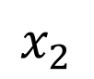
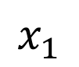
Resource Abstraction
Basic idea: Use linear inequalities to provide a compact representation of multi-domain network available bandwidth.
$$x_{1}$$
100
$$x_{2}$$
100
Geometrically, resource abstraction represents the bandwidth feasible region of network for providing bandwidths to this set of circuits.
Redundant inequalities are removed via a polynomial-time, optimal algorithm.
Notes:
Our idea: on-demand, partianl-instantiation

Slide 9
Can Resource Abstraction Handle Non-Unicast Circuits?
Basic idea: introduce auxiliary variables and additional equations.
Multicast circuit

Slide 10
Resource Abstraction: Multi-Path Circuit

Slide 11
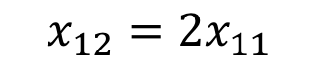
Resource Abstraction: Weight-Cost Multi-Path Circuit
Network M₁: Split the traffic of (S₁, e₁), (S₁, e₂) in a ratio of 1:2
$$x_{12}=2x_{11}$$

Slide 12
Resource Abstraction: Accuracy
Resource abstraction provides a compact, accurate representation of multi-domain network available bandwidth.
A fair optimal solution: $x_{1}=10, x_{2}=5, x_{3}=5$
Step 5
Notes:
Our idea: on-demand, partianl-instantiation

Slide 13
Resource Abstraction: Privacy Concern
Resource abstraction represents the bandwidth feasible region of network for providing bandwidths to this set of circuits.
Such regions are also private information.
Aggregator becomes single point of failure.
Step 5
Notes:
Our idea: on-demand, partianl-instantiation

Slide 14
Mercator: Key Components
Resource abstraction: Use linear inequalities to provide a compact representation of multi-domain network available bandwidth.
Resource abstraction obfuscating: Merge the resource abstraction of multiple domains without revealing the abstraction of individual domain.
Notes:
Our idea: on-demand, partianl-instantiation

Slide 15
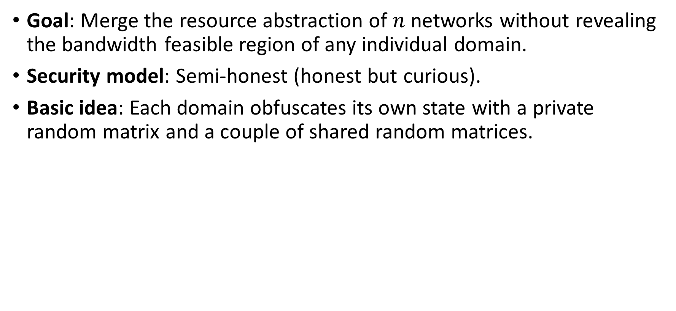
Resource Abstraction Obfuscating Protocol
Goal: Merge the resource abstraction of $n$ networks without revealing the bandwidth feasible region of any individual domain.
Security model: Semi-honest (honest but curious).
Basic idea: Each domain obfuscates its own state with a private random matrix and a couple of shared random matrices.
AS₂

Slide 16
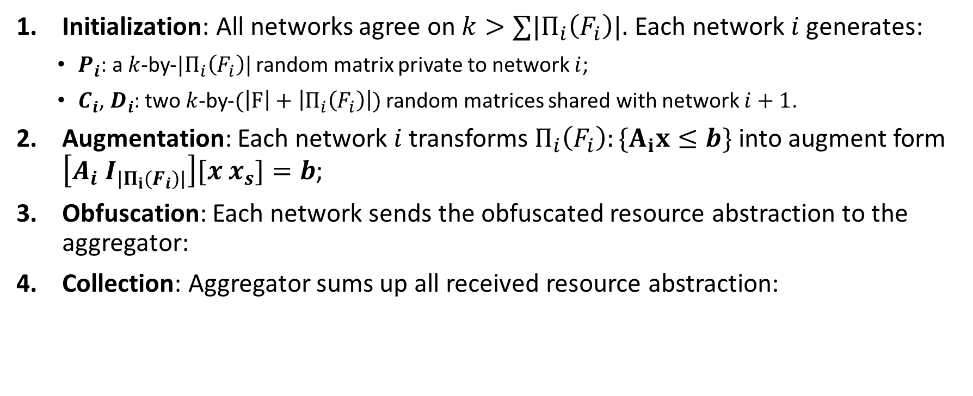
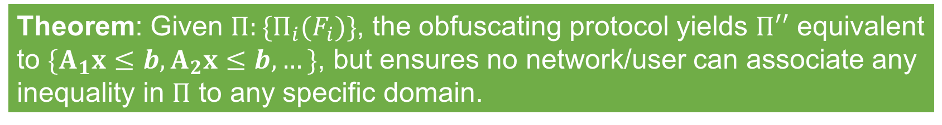
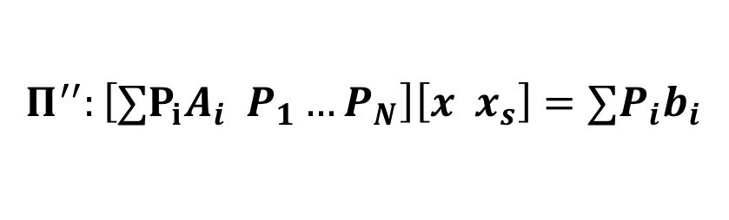
Resource Abstraction Obfuscating Protocol: Specification
Initialization: All networks agree on $k>∑|Π_{i}\left(F_{i}\right)|$. Each network $i$ generates:
$P_{i}$: a $k$-by-$|Π_{i}\left(F_{i}\right)|$ random matrix private to network $i$;
$C_{i}$, $D_{i}$: two $k$-by-$(\left|F\right|+\left|Π_{i}\left(F_{i}\right)\right|)$ random matrices shared with network $i+1$.
Augmentation: Each network $i$ transforms $Π_{i}\left(F_{i}\right):\{A_{i}x≤b\}$into augment form $\left[A_{i} I_{|Π_{i}(F_{i})|}\right][x x_{s}]=b$;
Obfuscation: Each network sends the obfuscated resource abstraction to the aggregator:
Collection: Aggregator sums up all received resource abstraction:
$$\left[P_{i}\left[A_{i} I_{|Π_{i}(F_{i})|}\right] −C_{i−1}+C_{i}\right]\left[x x_{s}\right]=P_{i}b_{i}−D_{i−1}+D_{i}$$
$$Π^{′′}:\left[{∑P}_{i}A_{i} P_{1}…P_{N}\right]\left[x x_{s}\right]={∑P}_{i}b_{i}$$
Theorem: Given $Π:\{Π_{i}(F_{i})\}$, the obfuscating protocol yields $Π′′$ equivalent to $\{A_{1}x≤b,A_{2}x≤b, …\}$, but ensures no network/user can associate any inequality in $Π$ to any specific domain.

Slide 17
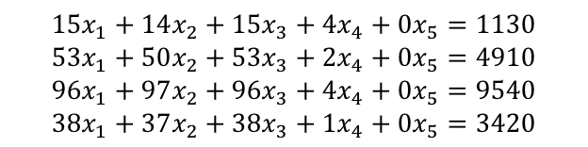
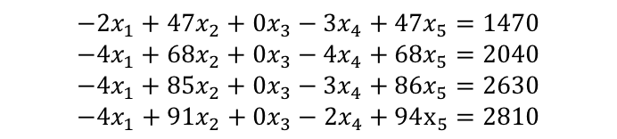

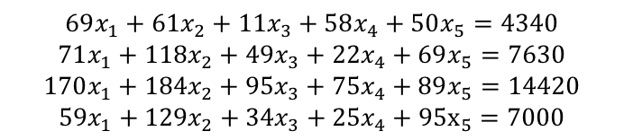
Resource Abstraction Obfuscating Protocol: Example
$$69x_{1}+61x_{2}+11x_{3}+58x_{4}+50x_{5}=4340$$
$$71x_{1}+118x_{2}+49x_{3}+22x_{4}+69x_{5}=7630$$
$$170x_{1}+184x_{2}+95x_{3}+75x_{4}+89x_{5}=14420$$
$$59x_{1}+129x_{2}+34x_{3}+25x_{4}+95x_{5}=7000$$
Aggregator
Maximizing $x_{1}+x_{2}$ subject to either feasible region would get the optimal solution $x_{1}=x_{2}=30$.
Mercator Server 1
Mercator Server 2
Mercator Server 3
$$15x_{1}+14x_{2}+15x_{3}+4x_{4}+0x_{5}=1130$$
$$53x_{1}+50x_{2}+53x_{3}+2x_{4}+0x_{5}=4910$$
$$96x_{1}+97x_{2}+96x_{3}+4x_{4}+0x_{5}=9540$$
$$38x_{1}+37x_{2}+38x_{3}+1x_{4}+0x_{5}=3420$$
$$−2x_{1}+47x_{2}+0x_{3}−3x_{4}+47x_{5}=1470$$
$$−4x_{1}+68x_{2}+0x_{3}−4x_{4}+68x_{5}=2040$$
$$−4x_{1}+85x_{2}+0x_{3}−3x_{4}+86x_{5}=2630$$
$$−4x_{1}+91x_{2}+0x_{3}−2x_{4}+94x_{5}=2810$$
$$56x_{1}+0x_{2}−4x_{3}+57x_{4}+3x_{5}=1740$$
$$22x_{1}+0x_{2}−4x_{3}+24x_{4}+x_{5}=680$$
$$78x_{1}+2x_{2}−x_{3}+74x_{4}+3x_{5}=2250$$
$$25x_{1}+0x_{2}+0x_{3}+25x_{4}+0x_{5}=770$$
$$Π_{1}\left(F_{1}\right):\left\{x_{1}+x_{2}≤100\right\}$$
$$Π_{2}\left(F_{2}\right):{\{x}_{1}≤30\}$$
$$Π_{3}\left(F_{3}\right):{\{x}_{2}≤30\}$$

Slide 18
Resource Abstraction: Scalability Concern
Issue: Computing and collecting resource abstraction for each request from scratch is expensive, and therefore may not be scalable.
Bottleneck: communication between Mercator domain servers and aggregator
Step 5

Slide 19
Mercator: Key Components
Resource abstraction: Use linear inequalities to provide a compact representation of multi-domain network available bandwidth.
Resource abstraction obfuscating: Merge the resource abstraction of multiple domains without revealing the abstraction of individual domain.
Super-set projection: Improve the system scalability via pre-computation and projection.
Notes:
Our idea: on-demand, partianl-instantiation

Slide 20
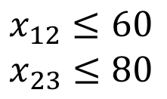
Resource Abstraction Super-Set Projection
Basic idea: Proactively discover the resource information for a set of circuits between every pair of source and destination networks, and project the collected information to derive the responses to user’s requests.
Example: Aggregator proactively discovers the resource abstraction for circuits between 3 member networks.
Aggregator
What is the resource information of two circuits: one from M₁ to M₂, and one from M₂ to M₃.
$$x_{12}≤60$$
$$x_{23}≤80$$

Slide 21
Performance Evaluation
Topology: LHCONE: a science federation network of 62 member networks
Intradomian topology: randomly chosen from Topology Zoo
Traffic: 48-hour CMS trace data
Metrics: throughput, fairness, latency, scalability, …

Slide 22
Benefits of Mercator
Objective: max-min fairness
Objective: total throughput
An average of 2x improvement of fairness
An average of 15% improvement of throughput

Slide 23
Benefits of Mercator
Request failure ratio of probe-requests-based systems
Resource discovery latency
An average of 100x improvement of resource discovery latency
Probe-requests-based systems have an average of 73% request failure ratio.

Slide 24
Efficiency of Resource Abstraction Obfuscating
Obfuscating latency
Obfuscated data transmission
The resource abstraction obfuscating protocol scales to up to 200 member network.

Slide 25
Efficiency of Super-Set Projection
Scalability via super-set projection
Update latency
Super-set projection decreases the average resource discovery latency by around 2 times, and scales to up to 200 member network.

Slide 26
Summary
The lack of visibility of network state (topology, policy and etc.) leads to substantial inefficiency of network resource reservation systems.
We design Mercator, a multi-domain network resource discovery System, to provide fine-grained, global network resource information, to optimize large-scale, multi-domain data transfers.
Key components:
Resource abstraction: Use linear inequalities to provide a compact representation of multi-domain network available bandwidth domains.
Resource abstraction obfuscating: Merge the resource abstraction of multiple domains without revealing the abstraction of individual domain.
Super-set projection: Improve the system scalability via pre-computation and projection
Demonstration at SC'18
When: Tuesday – Thursday during SC'18 week
Where: Booth 1413 (Caltech Booth)
What: Multi-domain routing discovery and resource orchestration
Contact: Qiao Xiang (qiao.xiang@cs.yale.edu)

